Slide 1
Dimensionality Reduction : A Comparative Study
Aayush Mudgal [12008]
Sheallika Singh [12665]

Slide 2
What is Dimensionality Reduction ?
Mapping of data to lower dimension such that:
        uninformative variance is discarded,
        or a subspace where data lives is detected
Why dimensionality reduction ?
Reduce Curse of dimensionality:
Requires larger number of observations to train the model efficiently
Better interpretation of models and visualization of data
Reduces the computational cost
Notes:
Makes infeasible method feasible

Slide 3
Assumptions of dimensionality reduction
Higher dimensional Data lies on a much lower dimensional manifold

Slide 4
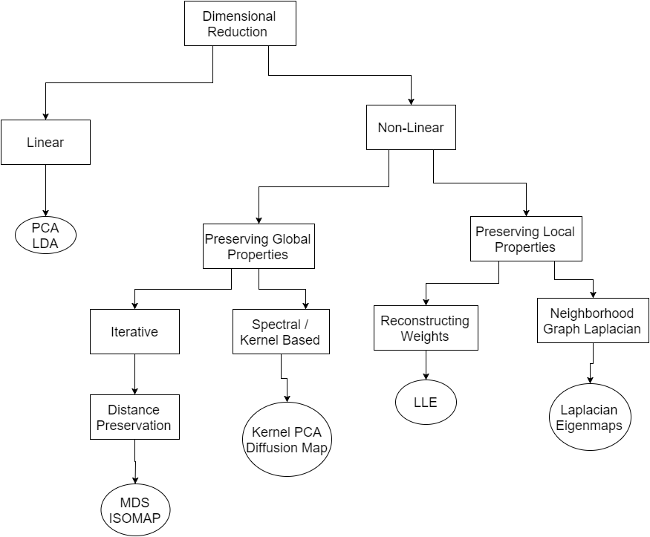
Dimensionality reduction !
Notes:
On the basis of linearity of the algorithm methods have been classified : showing
Global : Assume equal importance of all pairwise measures used in the algo
Choose the low dimension pairwise measure to fit the high dimension ones (using magnitude or rank order)
Local: Assume only the local distances are reliable in high dimension
Puts more weight on modeling the local distances correctly

Slide 5
Assume equal importance of all pairwise distances
Local Methods
Assume only the local distances are reliable in high dimension
Choose the low dimension pairwise distances to fit the high dimension ones (using magnitude or rank order)
Global Methods
Puts more weight on modeling the local distances correctly

Slide 6
Independent Component Analysis (ICA)
Manifold Modelling
MultiDimensional Scaling (MDS)
Principal Component Analysis (PCA)
Kernel PCA
Canonical Correlation Analysis (CCA)
Locally Linear Embedding
Laplacian EigenMaps
Projective Methods
Diffusion Maps
Finding Low-dimensional dimensions that extracts useful information
Constructing a representation for data lying on a low dimensional manifold embedded in a high dimensional space
Notes:
Classification on the basis of type of method which are projective or manifold

Slide 7

Independent Component Analysis
Motivation for ICA: Cocktail party problem
Separate the mixed signal into sources
Assumption: different sources are independent
To give non trivial results source signals are required to be non-Gaussian

Slide 8
ICA Formulation
y=Ax
Where y is the observed signal, x is original signal
Assuming y is linear combination of independent components
ICA finds the projection direction which maximises the statistical independence
How is maximisation of independence done ?
  Minimise the mutual information
  Or maximise the non-Gaussianity

Slide 9
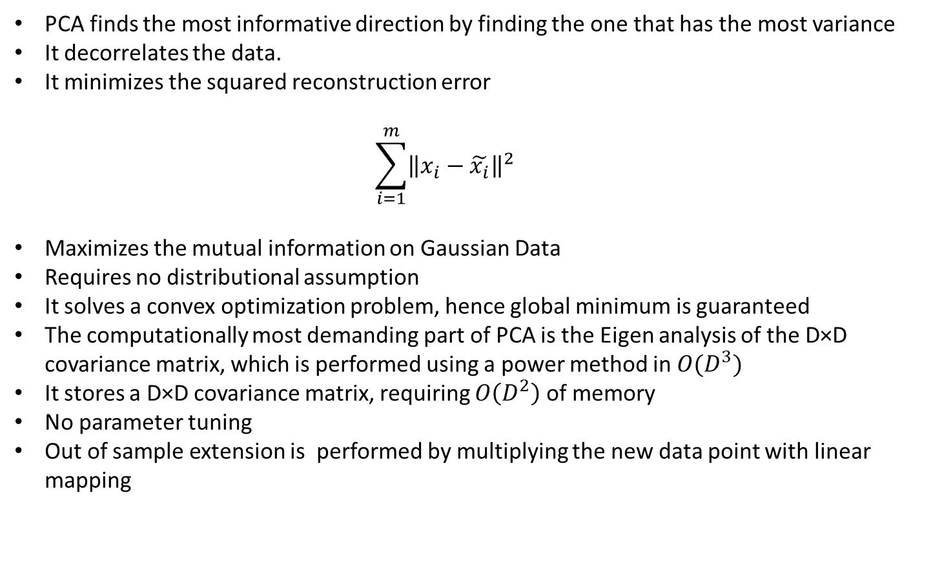
Principal Component Analysis
PCA finds the most informative direction by finding the one that has the most variance
It decorrelates the data.
It minimizes the squared reconstruction error
  $$\sum_{i=1}^{m}{{\left\|x_{i}−\tilde{x_{i}}\right\|}^{2}}$$
Maximizes the mutual information on Gaussian Data
Requires no distributional assumption
It solves a convex optimization problem, hence global minimum is guaranteed
The computationally most demanding part of PCA is the Eigen analysis of the D×D covariance matrix, which is performed using a power method in $O(D^{3})$
It stores a D×D covariance matrix, requiring $O\left(D^{2}\right)$ of memory
No parameter tuning
Out of sample extension is performed by multiplying the new data point with linear mapping
Notes:
Eigen vectors of covariance matrix are the solution
Decorrelates:
If we use the full set of orthonormal eigenvectors as a choice of basis. It comes out that the covariance of data in different direction is zero.
(given input vector x is expanded as x = d a=1 xaua for some orthonormal set {ua}, and in the new basis, the same vector is expanded as x = d b=1 x˜beb, so ˜xa ≡ x · ea = ea · b xbub. The mean µ ≡ 1 m i xi has components ˜µa = µ · ea in the new basis. The sample covariance matrix depends on the choice of basis: if C is the covariance matrix in the old basis, then the corresponding covariance matrix in the new basis is C˜ab ≡ 1 m i(˜xia − µ˜a)(˜xib − µ˜b) = 1 m i{ea · ( p xipup − µ)}{( q xiquq − µ) · eb} = e aCeb = λbδab)
Reconstruction error defined a s this is maximized by the choice of eigen vectors as new basis
If y=Wx X~N(0,C), y will also and choice of w as eigen vector matrix maximizes the mutual info between Y and X
Where D is the dimension of the original data

Slide 10
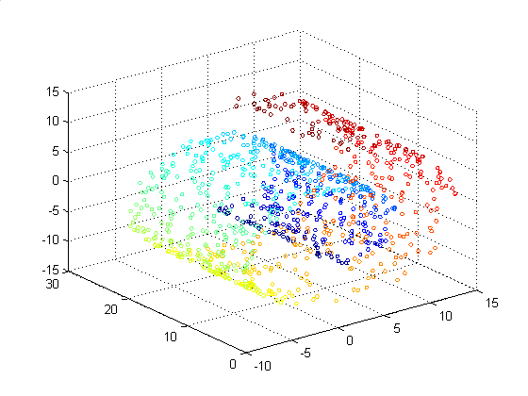
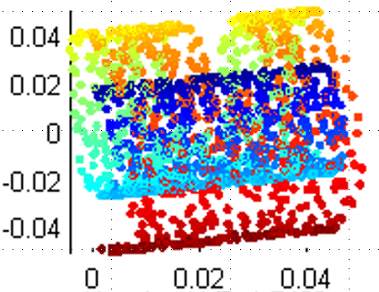
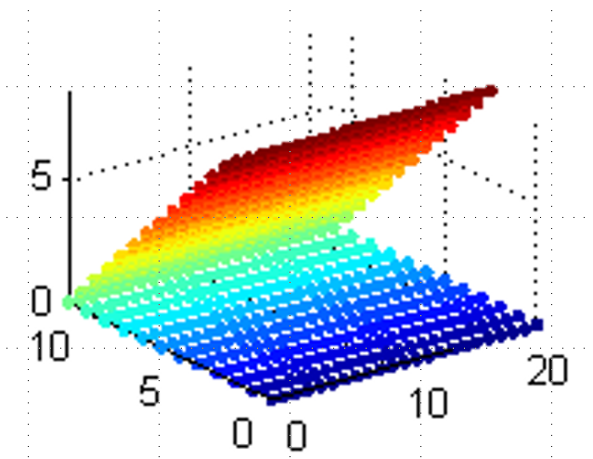
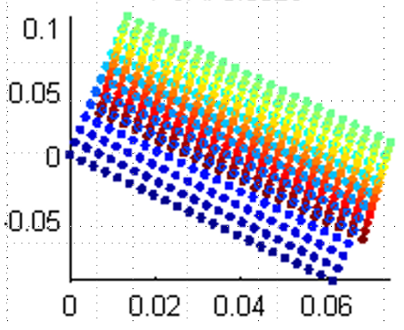
Swiss Roll
PCA uses no manifold information
  No geometry inference
  Can’t handle curvature or corners
  Can handle noise and sparsity
Cornered Plane

Slide 11
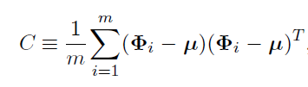





Kernel PCA
Uses kernel trick to create non-linear version of PCA in sample space, by performing ordinary PCA in F
Required tuning of Kernel parameters, but is similar to PCA in terms of time and space complexity
The covariance matrix of the mapped data in feature space
We are looking for the solutions v of :
Notes:
Because PCA method can be expressed in terms of inner product hence kernel trick can be used here
Mathematics involved

Slide 12


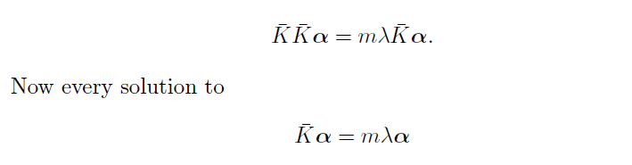
The k-th eigenvector
Since the v lie in the span of the , we can equivalently look for solutions of the m equation:
So,
So, `
is also a solution to above equation.

Slide 13
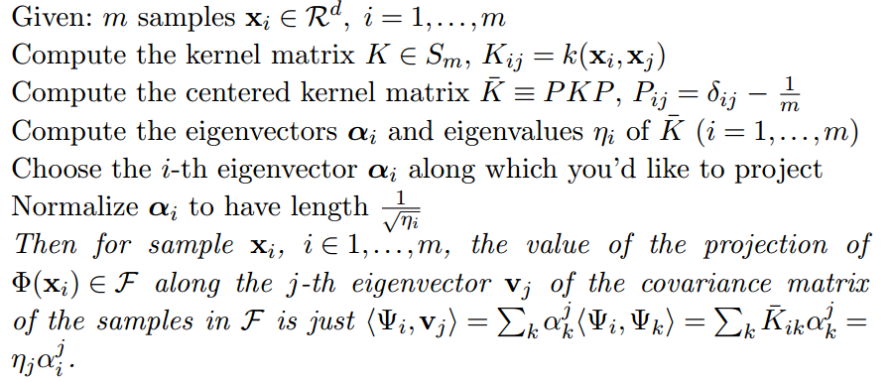
Algorithm : Kernel PCA (schematic)

Slide 14
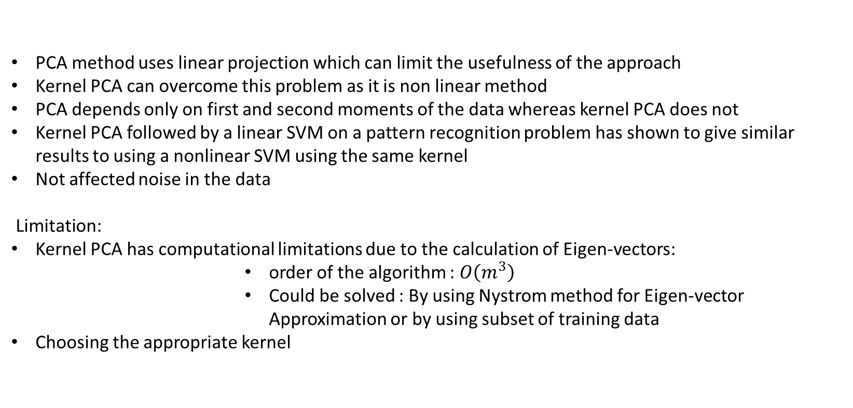
PCA v/s Kernel PCA
PCA method uses linear projection which can limit the usefulness of the approach
Kernel PCA can overcome this problem as it is non linear method
PCA depends only on first and second moments of the data whereas kernel PCA does not
Kernel PCA followed by a linear SVM on a pattern recognition problem has shown to give similar results to using a nonlinear SVM using the same kernel
Not affected noise in the data
Limitation:
Kernel PCA has computational limitations due to the calculation of Eigen-vectors:
            order of the algorithm : $O\left(m^{3}\right)$
            Could be solved : By using Nystrom method for Eigen-vector Approximation or by using subset of training data
Choosing the appropriate kernel
Notes:
Noise or data as mean is subtracted from each points
DataSets for Kernel PCA : Image datasets
yes κ(·, ·) O(n 3 ) O(n 2 )

Slide 15
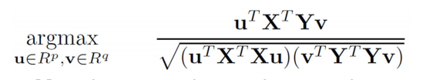

Canonical Correlation Analysis
CCA is a way of measuring the linear relationship between two multidimensional variables.
CCA finds a projection direction u in the space of X, and a projection direction v in the space of Y, so that projected data onto u and v has max correlation
The dimension of these new bases is less than or equal to the smallest dimensionality of the two set of variables (X and Y).So CCA simultaneously finds dimension reduction for tow feature spaces
CCA formulation :
then solving
CCA is invariant under invertible Affine Transformations, the projections( u.x and v.y) and correlation between them remain invariant
De-correlates the data
CCA can be kernelised
Notes:
If the X and Y matrix are transformed under invertible affine transformations then also the projections remains the same along the u and v
CCA can be seen as a variation of pCA so can be kernelised in the same way
Kernel CCA follows kernel PCA in spirit. The data x1 ∈ Rd1 , x2 ∈ Rd2 are mapped to feature spaces F1 and F2 by maps Φ1, Φ2, respectively (note that F1 and F2 may or may not be the same). Since the w1i ∈ F1, w2i ∈ F2 are used only to take projections, we can assume 3.6 Canonical Correlation Analysis 313 that they lie in the span of the data, so that there exist αp such that: wp = m i=1 αpiΦp(xpi), (3.39) where we have dropped the index enumerating the w’s (and the corresponding index on the αs) for clarity. Thus, for a given solution, αp ∈ Rm. Since CCA depends only on inner products the Φ’s are never explicitly needed: wp · Φp(xpj ) = m i=1 αpiΦp(xpi),Φp(xpj ) = m i=1 αpiKp(xpi,xpj ). (3.40) Following the above analysis, but in the spaces Fp, yields: ρ = max α1,α2 α
1K1K2α2 α 1K2 1α1α 2K2 2α2 ,

Slide 16
Nystrom Method
Compute partial affinities
affinities within
X
affinities between
X and Y
n points
W =
l sample points
O (n²)
Z = X U Y
complexity:
O (l . n)

Slide 17


Nyström Method
Approximate Eigenvectors
$$\sum{\tilde{W}=\frac{n}{l}\sum{A}}$$
A
B
$$\tilde{U_{A}}= \sqrt{\frac{l}{n}}∗C∗U_{W}{\sum{W}}^{−1}$$
W =
, A = UΛU^{T}
B^{T}
C
complexity:
U
U =
O (n³)
B^{T}UΛ⁻¹
approximate eigenvectors
O (l² . n)

Slide 18

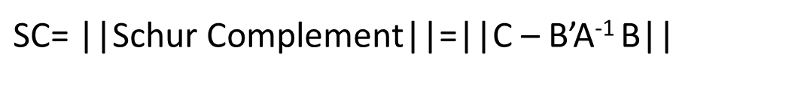
Schur Complement
T
U
U
A
B
W =
UΛU^{T =}
Λ
⁼
B^{T}
B^{T}A⁻¹B
B^{T}UΛ⁻¹
B^{T}UΛ⁻¹
$$a^{2}+b^{2}=c^{2}$$
A
B
W =
B^{T}
C
$\text{SC}\text{= ||}\text{Schur} \text{Complement}\text{||=}$||C – B’A⁻¹ B||

Slide 19
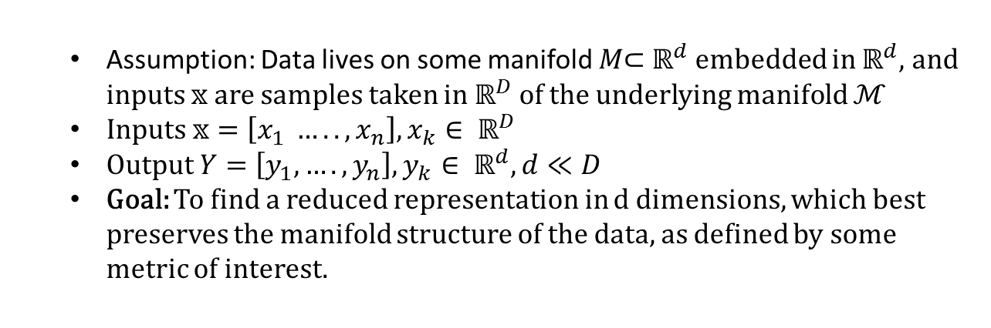
Manifold Modelling
  Assumption: Data lives on some manifold $M\text{⊂} ℝ^{d}$ embedded in $ℝ^{d}$, and inputs $𝕩$ are samples taken in $ℝ^{D}$of the underlying manifold $ℳ$
  Inputs $𝕩=\left[x_{1} ….., x_{n}\right], x_{k}∈ ℝ^{D}$
  Output $Y=\left[y_{1},….,y_{n}\right], y_{k}∈ ℝ^{d}, d≪D$
  Goal: To find a reduced representation in d dimensions, which best preserves the manifold structure of the data, as defined by some metric of interest.
R^{n}
M
R²
z
X₂
x
x : coordinate of z
X₁
Notes:
Manifold : A manifold is a topological space which is locally Euclidean. In general, any object which is nearly "flat" on small scales is a manifold
Embedding: is a representation of a topological object, manifold, graph, field, etc. in a certain space in such a way that its connectivity or algebraic properties are preserved.

Slide 20


Metric Multi-Dimensional Scaling
Aim: To find low dimensional representatives, y, for the high- dimensional data-points, x, that preserve pairwise distances as well as possible.
Possible Algorithm: Steepest Descent Algorithm
Since we are, minimizing squared errors, this might be related with PCA?
  If so, we don’t need an iterative method to find the best embedding.
Raw-Stress Function (Linear)
Samon-Stress Function (Non-Linear)
Notes:
Samon stress function: Puts more emphasis on distances that were originally small
MDS is widely used for the visualization of data, e.g., I
n fMRI analysis and
in molecular modelling
The popularity of MDS has led to the proposal of variants such as SPE [3], CCA [32], SNE [54,81], and FastMap [39].

Slide 21
Converting Metric MDS to PCA
Double Centering : Metric MDS is equivalent to PCA
  But it may introduce spurious structure
If the data-points all lie on a hyperplane, their pairwise distances are perfectly preserved by projecting the high-dimensional co-ordinates onto the hyperplane.

Slide 22
Multi-Dimensional Scaling : Summary
MDS could be extended for use on ordinal values
Landmark MDS : It is used to solve the bottleneck in classical MDS, and uses a subset of data. Scalability is increased but approximation is noise sensitive
If the data-points all lie on a hyperplane, their pairwise distances are perfectly preserved by projecting the high-dimensional co-ordinates onto the hyperplane
Like PCA it can neither understand geometry nor handle non-convexity, and curvature
Does not require assumptions of linearity, metricity, or multivariate normality

Slide 23
Graph Based Algorithms
Find K-nearest Neighbors
Estimate local properties of manifold by looking at neighborhoods found
Find a global embedding that preserves the properties found in Step 2.
Isomaps
Local Linear Embedding
Laplacian EigenMaps

Slide 24
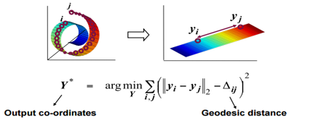
Isomaps:
Find K-nearest Neighbors
Construct a neighborhood graph and compute the shortest path between any two vertices
Find a global embedding that preserves the properties found in Step 2 (may use MDS)
Finding low dimensional distribution that best preserves the Geodesic distance

Slide 25
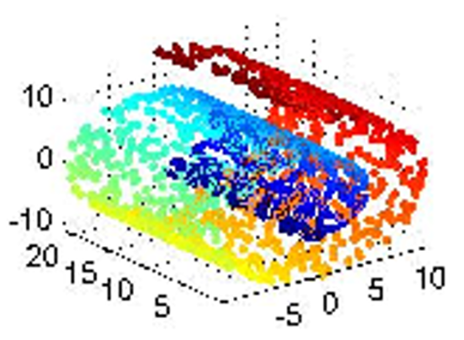
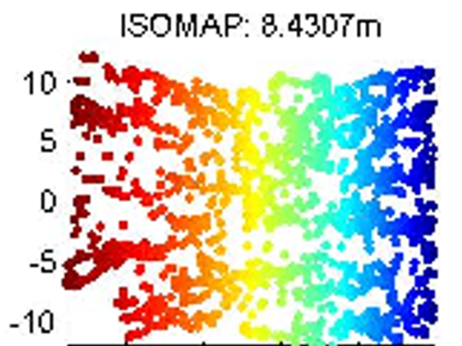
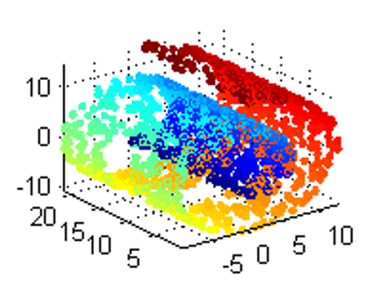
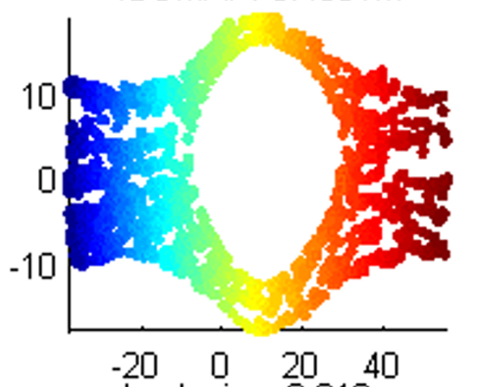
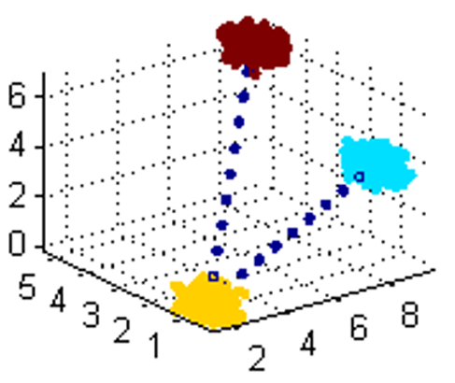
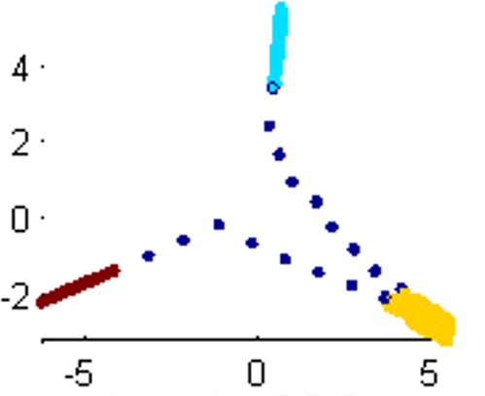
Isomaps:
  It is able to infer geometry to some extent, Isomap can unroll the swiss roll
  It is able to handle clusters and corners
  It is able to handle non-uniform sampling
  It fails to handle non-convex manifolds

Slide 26
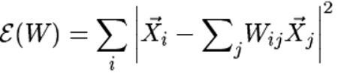
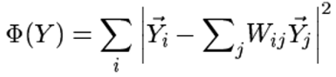
Local Linear Embedding (LLE)
Assumption: manifold is approximately “linear” when viewed locally
Find the neighbors of each data point
Compute the weights $W_{ij}$ that best reconstruct each data point from its neighbors, minimizing the cost by constrained linear fits
Compute the weights 𝑊_𝑖𝑗 that best reconstruct each data point from its neighbors, minimizing the cost by constrained linear fits
Compute output vectors best reconstructed by the weights $W_{ij}$, minimizing the quadratic form by its bottom non-zero eigenvectors
Compute output vectors best reconstructed by the weights 𝑊_𝑖𝑗, minimizing the quadratic form by its bottom non-zero eigenvectors
Xi
Xj
Wij
Xi
Wik
Xk
Select neighbors
Reconstruct with linear weights

Slide 27
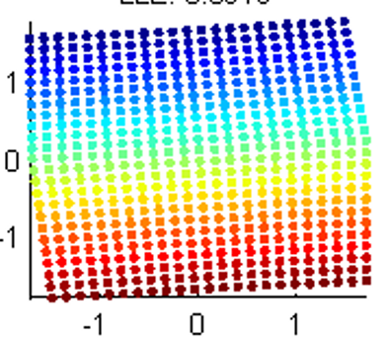
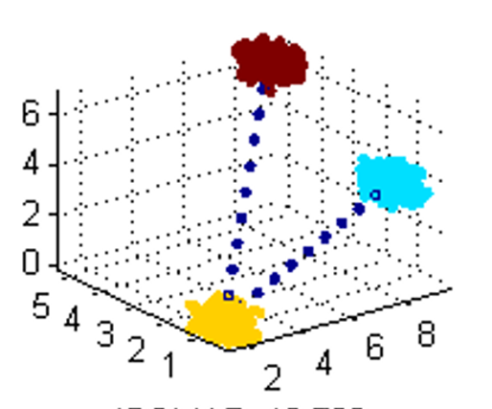
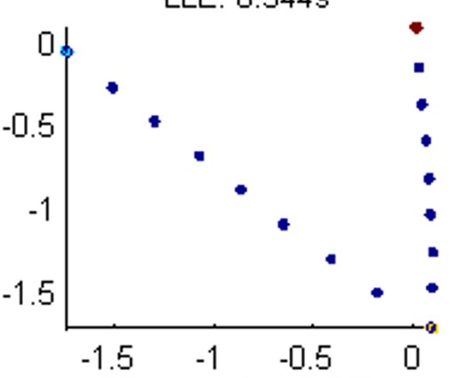
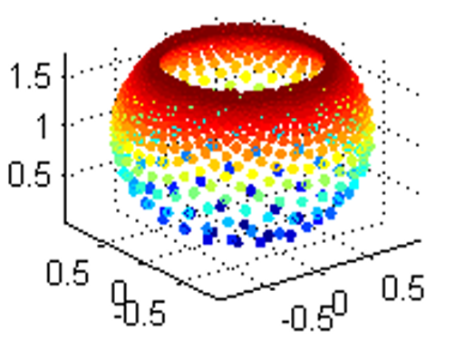
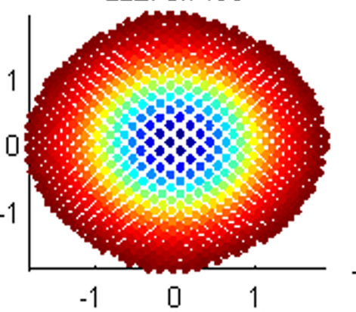
  It is able to infer geometry to some extent
  It is unable to handle clusters
  It is sensitive to parameters
  It is able to handle corners
  It may handle non-convexity

Slide 28
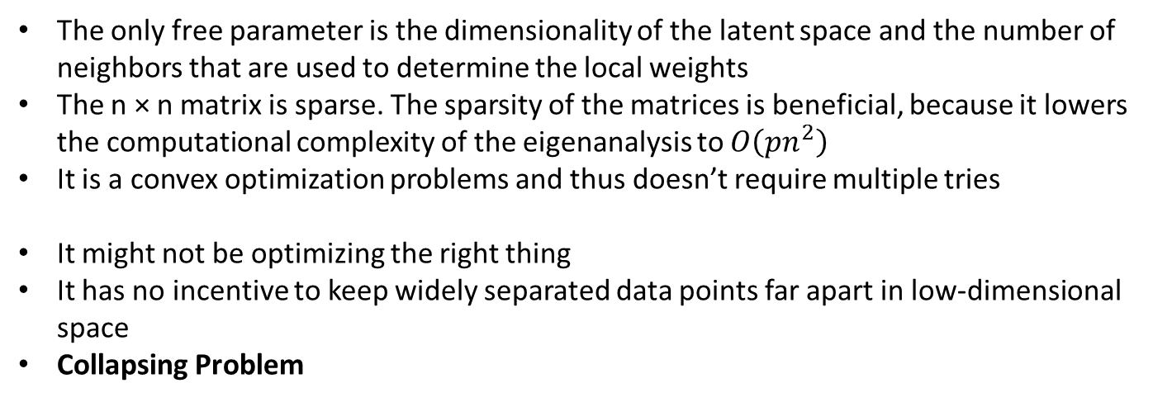
Local Linear Embedding
The only free parameter is the dimensionality of the latent space and the number of neighbors that are used to determine the local weights
The n × n matrix is sparse. The sparsity of the matrices is beneficial, because it lowers the computational complexity of the eigenanalysis to $O\left(pn^{2}\right)$
It is a convex optimization problems and thus doesn’t require multiple tries
It might not be optimizing the right thing
It has no incentive to keep widely separated data points far apart in low-dimensional space
Collapsing Problem

Slide 29
Laplacian Eigen Maps
It reflects the intrinsic geometric structure of the manifold
The manifold is approximated by the adjacency graph computed from the data points
The Laplace Bleltrami operator is approximated by the weighted Laplacian of the adjacency graph
The low dimensional representation preserves the local neighborhood information in a certain sense

Slide 30
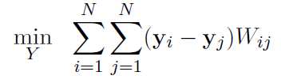

Laplacian of a Graph
Let G(V,E) be a undirected graph without graph loops. The Laplacian of the graph is
d_{ij} if i=j (degree of node i)
L_{ij} = -1 if i≠j and (i,j) belongs to E
0 otherwise
Eigenmaps Ly = λDy
Ly₀ = λ₀Dy₀, Ly₁ = λ₁Dy₁ …
0= λ₀≦ λ₁≦… ≦ λ_{n-1}
x_{i} → (y₀(i), y₁(i),…, y_{m}(i))

Slide 31
Constructing the adjacency graph
Construct the adjacency graph to approximate the manifold
3
1
2
4
3
-1
-1
3
-1
-1
L =
=R-W
-1
0
0
-1
︰
0
︰

Slide 32
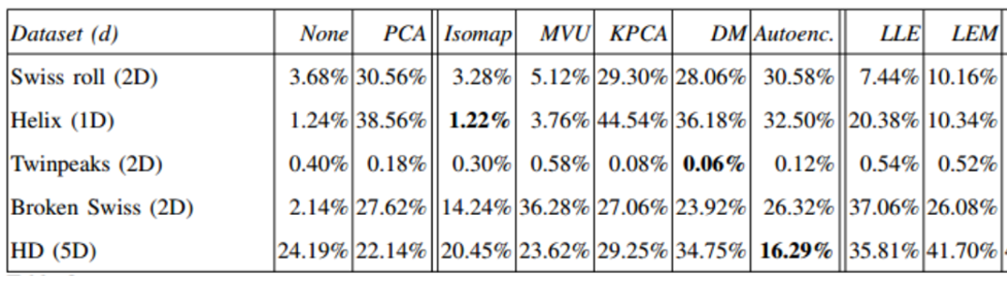
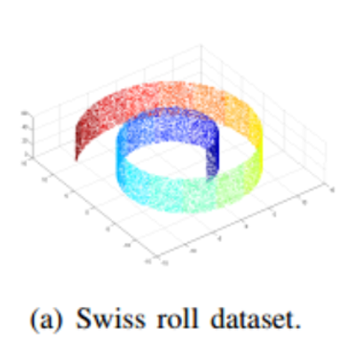
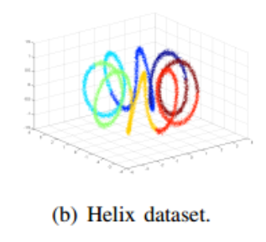
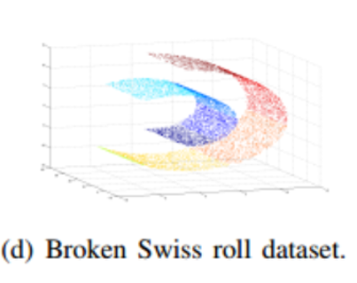
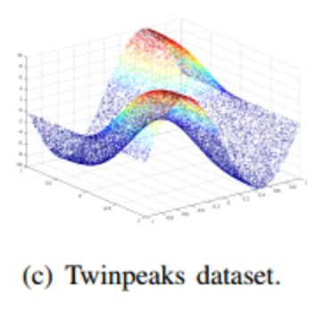
Do non-linear methods really help?
Generalization error of 1-NN classifier on artificial datasets
Dimensionality Reduction: A Comparative Review L.J.P. van der Maaten ∗ , E.O. Postma, H.J. van den Herik

Slide 33
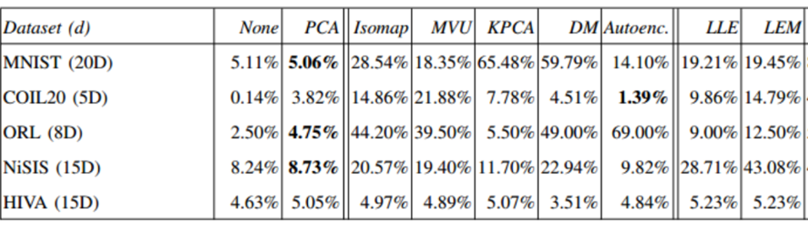
Do non-linear methods really help?
Dimensionality Reduction: A Comparative Review L.J.P. van der Maaten ∗ , E.O. Postma, H.J. van den Herik
Generalization error of 1-NN classifier on natural datasets
MNIST : 60,000 handwritten digit dataset. Images have 28x28 pixels, points in 784-dimensional space
COIL20 : Images of 20 different object depicted from 72 viewpoints, leading to 1,440 images (32x32) pixels yielding 1,024 dimensional space
NiSIS : Dataset for pedestrian detection, 3,675 grayscale images 36x18 pixels in a 648 dimensional space
ORL : Face recognition dataset, 400 grayscale images 112 × 92 pixels that depict 40 faces under various conditions (i.e., the dataset contains 10 images per face)
HIVA : drug discovery dataset with two classes. It consist of 3,845 datapoints with dimensionality 1,617

Slide 34
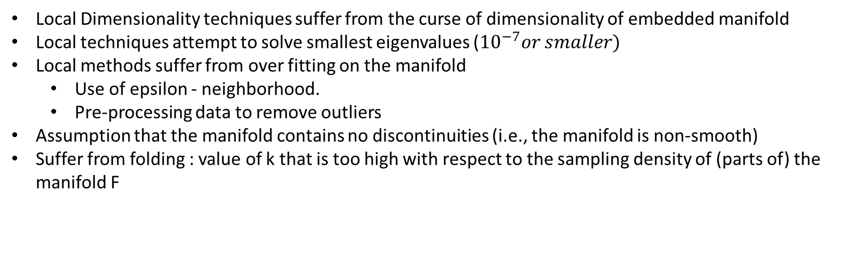
Explanation
Local Dimensionality techniques suffer from the curse of dimensionality of embedded manifold
Local techniques attempt to solve smallest eigenvalues (${10}^{−7}or smaller)$
Local methods suffer from over fitting on the manifold
  Use of epsilon - neighborhood.
  Pre-processing data to remove outliers
Assumption that the manifold contains no discontinuities (i.e., the manifold is non-smooth)
Suffer from folding : value of k that is too high with respect to the sampling density of (parts of) the manifold F
Notes:
Number of datapoints that is required to characterize a manifold properly grows exponentially with the intrinsic dimensionality of the manifold.
For artificial datasets with low intrinsic dimensionality such as the Swiss roll dataset, this weakness does not apply. However, in most real-world tasks, the intrinsic dimensionality of the data is much higher. For instance, the face space is estimated to consist of at least 100 dimensions [79]. As a result, the performance of local techniques is poor on many real-world datasets, which explains the results of our experiments with the HD dataset and the natural datasets.
Eigenproblems with these properties are extremely hard to solve, even for state-of-the-art eigensolvers. The eigensolver may not be able to identify the smallest eigenvalues of the eigenproblem, and as a result, the dimensionality reduction technique might produce suboptimal solutions. The good results of Isomap (that searches for the largest eigenvalues) compared to local techniques (that search for the smallest eigenvalues) may be explained by the difficulty of solving eigenproblems.
Third, local properties of a manifold do not necessarily follow the global structure of the manifold (as noted in, e.g., [19,93]) in the presence of noise around the manifold. In other words,
The results of our experiments with the broken Swiss dataset illustrate the incapability of current dimensionality reduction techniques to model non-smooth manifolds. Not likely in real word datasets
The relatively good results of Isomap may be explained from the presence of a large number of ‘short-circuits’ in the neighborhood graph, as a result of which the neighborhood graph shows large resemblance to a random network. In such a network, the distances through the graph are strongly correlated to the (squared) Euclidean distances 12 , and Isomap thus 12In the Erdos-R ¨ enyi random network [38] on a Euclidean space, the ´ shortest path between two points through the network is correlated 17 reduces to MDS and PCA. The relatively good results of MVU may be explained by the maximization of the variance in the low-dimensional data representation that MVU performs. This maximization causes originally distant points to be far apart in the low-dimensional data representation as well, even when the constraints on the maximization do not follow the local structure of the manifold

Slide 35
Conclusion
Nonlinear techniques do not yet clearly outperform traditional PCA
On selected datasets, nonlinear techniques outperform linear techniques, but on perform poorly oon various other natural datasets
Need to shift focus towards development of techniques that have objective functions that can be optimized well in practice.
Strong performance of autoencoders reveal that these objective functions may not be necessarily convex

Slide 36
Conclusion
Laplacian eigenmap provides a computationally efficient approach to non-linear dimensionality reduction that has locality preserving properties
Ham et al. [46] show how that Laplacian eigenmaps, LLE, and Isomap can be viewed as variants of kernel PCA.
Platt [70] links several flavors of MDS by showing how landmark MDS is in fact Nystr¨om algorithms
Despite the mathematical similarities of LLE, Isomap, and Laplacian Eigenmaps, their different geometrical roots result in different properties:
  for example, for data which lies on a manifold of dimension d embedded in a higher dimensional space, the eigenvalue spectrum of the LLE and Laplacian Eigenmaps algorithms do not reveal anything about d, whereas the spectrum for Isomap (and MDS) does.

Slide 37
References
Dimensionality Reduction: A Comparative Review L.J.P. van der Maaten ∗ , E.O. Postma, H.J. van den Herik
Large-Scale Manifold Learning, Ameet Talwalkar and Sanjiv Kumar and Henry A. Rowley, Computer Vision and Pattern Recognition (CVPR), 2008
Laplacian Eigenmaps for Dimensionality Reduction and Data Representation, M. Belkin and P. Niyogi,Neural Computation, pp. 1373–1396, 2003
Dimensionality Reduction: A Guided Tour, C.J.C. Burges, Foundations and Trends in Machine Learning, 2010
An Introduction to Locally Linear Embedding, Lawrence K. Saul, AT&T Labs – Research, 180 Park Ave, Florham Park, NJ 07932 USA
Lecture Notes on Data Mining by Cosma Shalizi, http://www.stat.cmu.edu/~cshalizi/350/
Probabilistic Principal Component Analysis, Journal of the Royal Statistical Society, Seires B, 61 Part 3

